Slide 1
2024 Winter Sports Meeting
Flagstaff High School’s 102nd Year

Slide 2
Introductions:
Libby Miller, Principal
Frank Alvillar, Asst. Principal
Matthew Barquin, Asst. Principal
Jeannine Brandel, Athletic Director
Donte’ Delia, Athletic Trainer
Martin Reyes, Boys’ Basketball
Tyrone Johnson, Girls’ Basketball
Mike Jenkins, Boys’ Soccer
Savannah Berry, Girls’ Soccer
Andres Delgadillo, Wrestling

Slide 3
Jeannine Brandel, Athletic Director
Flagstaff High School
400 West Elm
Flagstaff AZ 86001
Office Phone:
(928) 773-8105
Cell Phone:
(928) 607-4250
Email:
jbrandel@fusd1.org

Slide 4
Donte’ Delia, Athletic Trainer
Flagstaff High School
400 West Elm
Flagstaff AZ 86001
Office Phone:
(928) 773-8140
Cell Phone:
(623) 824-9680
Email:
ddelia@fusd1.org

Slide 5
ATHLETIC TRAINER
CONCUSSION PROTOCOL
Return to Play
Minimum 7 day progression back to play requirement
Twenty-four hours asymptomatic will begin the progression
Progression will be done with ATC/L until fully cleared
If symptoms return during progression student/athlete will start progression over
Return to Learn
Limited screen time
Standard adjustments will be in place 7 school days after diagnosis
If additional adjustments need to be made, parent may request meeting with teachers, counselors and ATC/L

Slide 6
For more information on concussion protocol and treatment, please go to the Athletic Training page on the FHS website.

Slide 7
ENVIRONMENTAL CONDITIONS
Heat Related Illness:
Heat Cramps
Minor Concern -- need to drink fluids
Heat Exhaustion
Moderate Concern -- Athletic Trainer
Heat Stroke
911
Heat Acclimatization
Progression
Cold Related Illness:
Frostnip
Most Common, easy to resolve
Frostbite
Possible Hospital visit if not treated
Hypothermia
911

Slide 8
OPIOID EDUCATION
Opioid Use is a serious issue that we believe requires all of us to act together. The State of Arizona along with the Arizona Interscholastic Association requires education be presented to our students each year. The AIA put forth a new course through the AIA Academy entitled Opioid Education. All students must complete this prior to being eligible for participation. This like Brainbook will be once in a student’s high school career.
A good reminder:
If you as a parent or teammate are concerned about a friend or teammate who may be using/abusing opioids; do not be afraid to reach out to a coach, a teacher, a counselor, an Athletic Trainer, or the Athletic Director to share your concerns.

Slide 9
COVID IMPACT ON SPORTS
Standard Stay Healthy Procedures for ALL Members of the Athletic Community
Stay home when sick.
Wash hands frequently for at least 20 seconds.
Use sanitizer.
Cover your mouth and face if you sneeze or cough (sneeze or cough into your elbow).
Avoid touching face with hands.
Avoid physical contact
WEAR MASKS if practical – not required
Athlete Positive:
Isolate a minimum of 5 days
Don’t hurt the team – it’s better
to miss 5 days than to bring down
the whole team.
Don’t share water bottles.
Be Smart!
Additional Information Available on the District and Athletic Website

Slide 10
CLEARANCE PROCESS
Students will need to complete the following:
Physical Examination ~ Dated on or after March 1, 2024
Physical Evaluation ~ Signed by the physician
Brainbook ~ Education done once in a student’s high school career
Opioid Education Course ~ Education done once in a student’s high school career
Online Registration through FinalForms ~ Filled out by parents
Submit Original Forms ~ No pictures

Slide 11
REGISTRATION PROCESS:
Parents fill out/sign on FinalForms Students sign on FinalForms Physical AIA Courses Make sure you use a password you can remember so you can go back in to review or update.

Slide 12
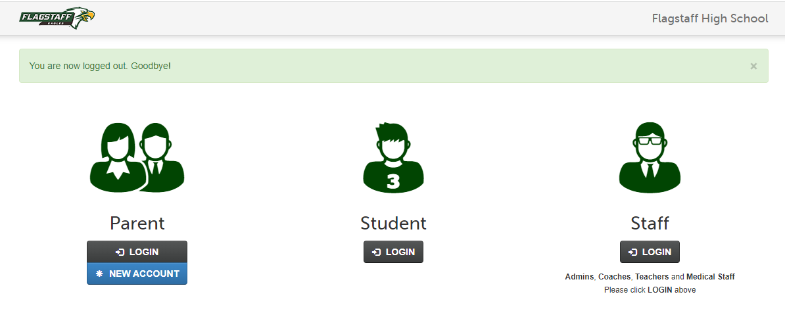
FinalForms ~ https://flagstaff-az.finalforms.com/

Slide 13
Registration ~ FinalForms

Slide 14
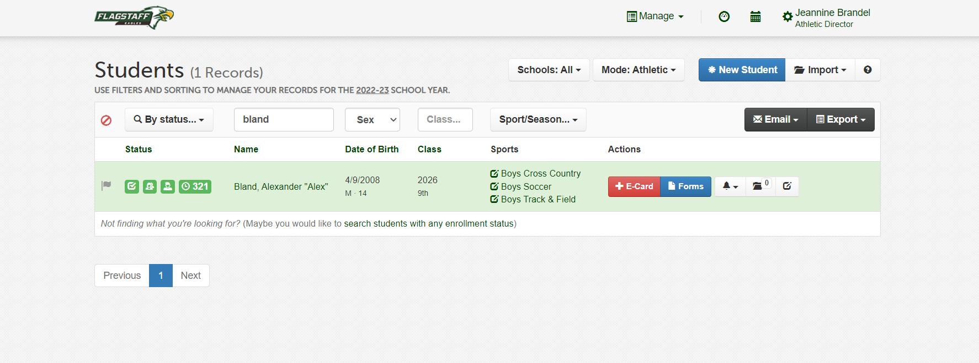
Registration ~ FinalForms

Slide 15
Registration ~ FinalForms

Slide 16
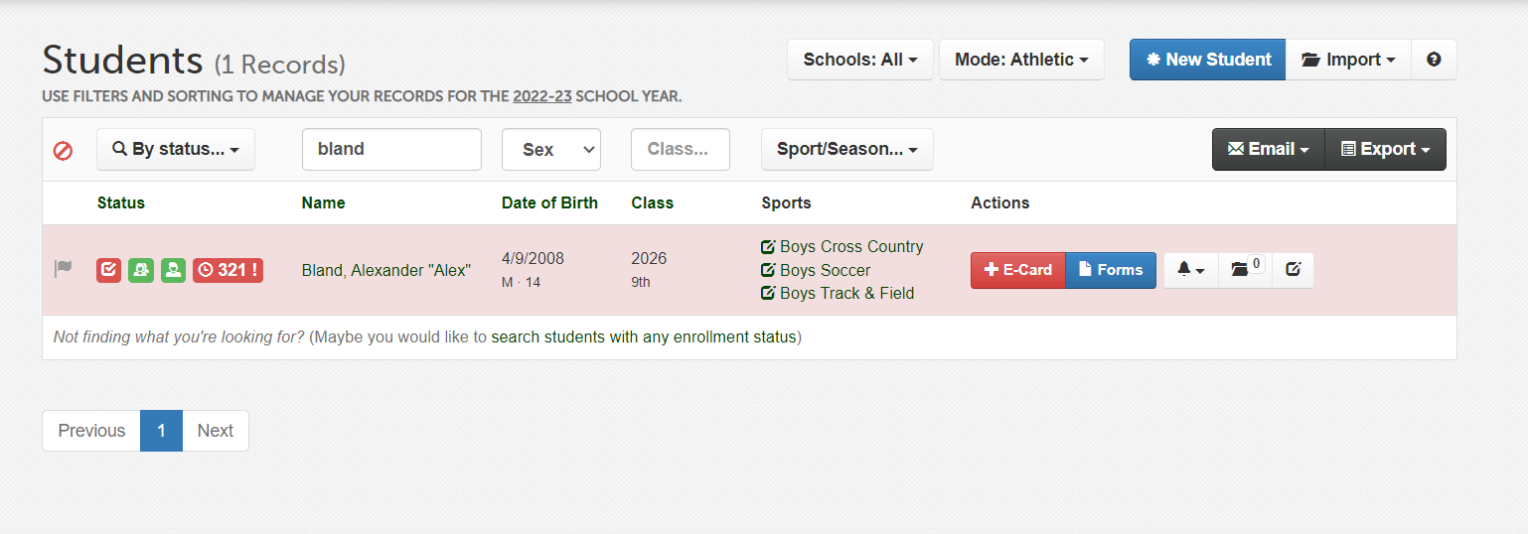
Registration ~ FinalForms

Slide 17
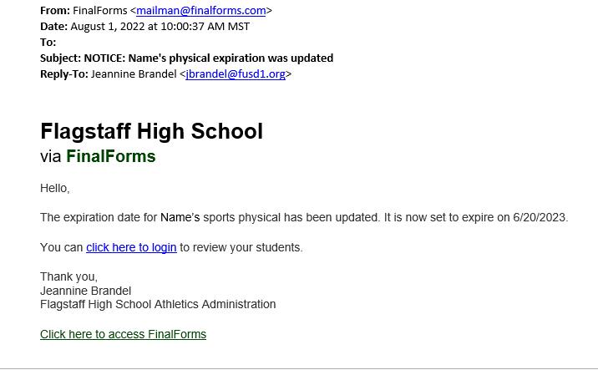
Registration ~ FinalForms

Slide 18
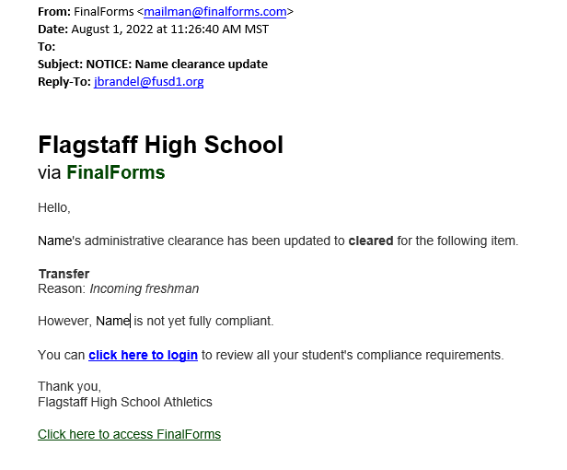
Registration ~ FinalForms

Slide 19
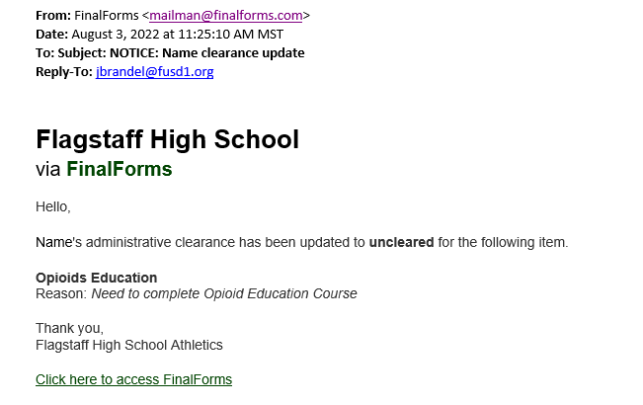
Registration ~ FinalForms

Slide 20
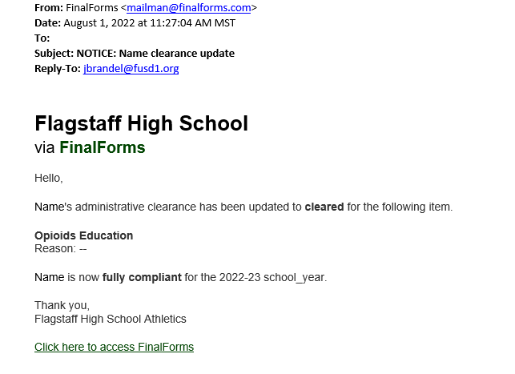
Registration ~ FinalForms

Slide 21
AIA PARTICIPATION FEE
$200 a year
$325 Family Cap
For non-cut sports payable upon registration
Cut Sports pay once teams are formed
Non-Refundable/Tax Credit Eligible
Helps cover the cost of programs
Students who are recipients of the Empowerment Scholarship Account (ESA) must notify FUDS of their ESA status and are expected to pay participation fees in athletics/activities/performing arts at 2.5 times the annual fee. ESA students are not eligible for the Family Max

Slide 22
SCHEDULES
Schedules are available on the AIA website.
Go to:
http://www.azpreps365.com/schools/flagstaff
Tickets for home events will be through GoFan
Tickets are Online Only ~ No Cash

Slide 23
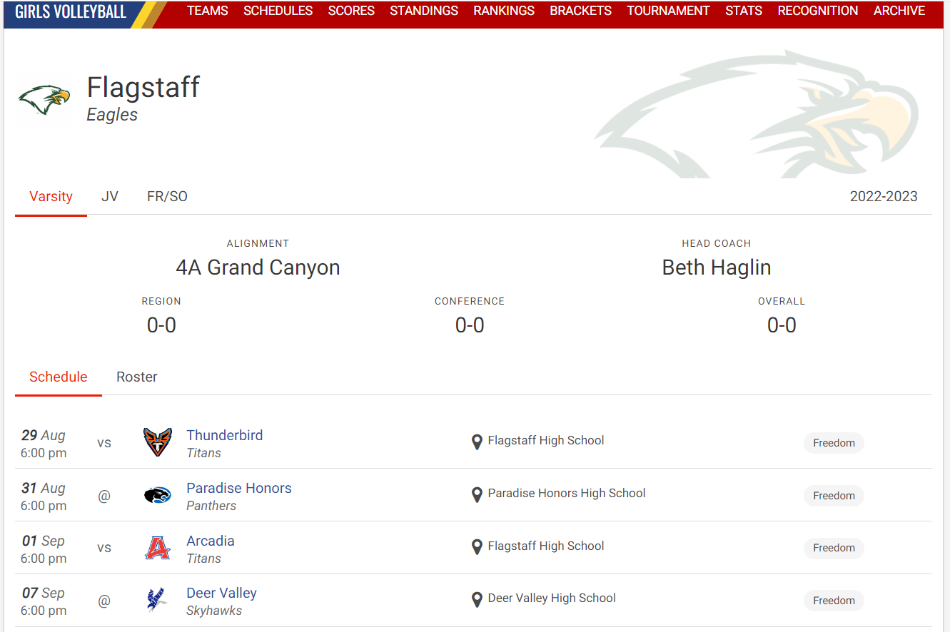
Schedules

Slide 24
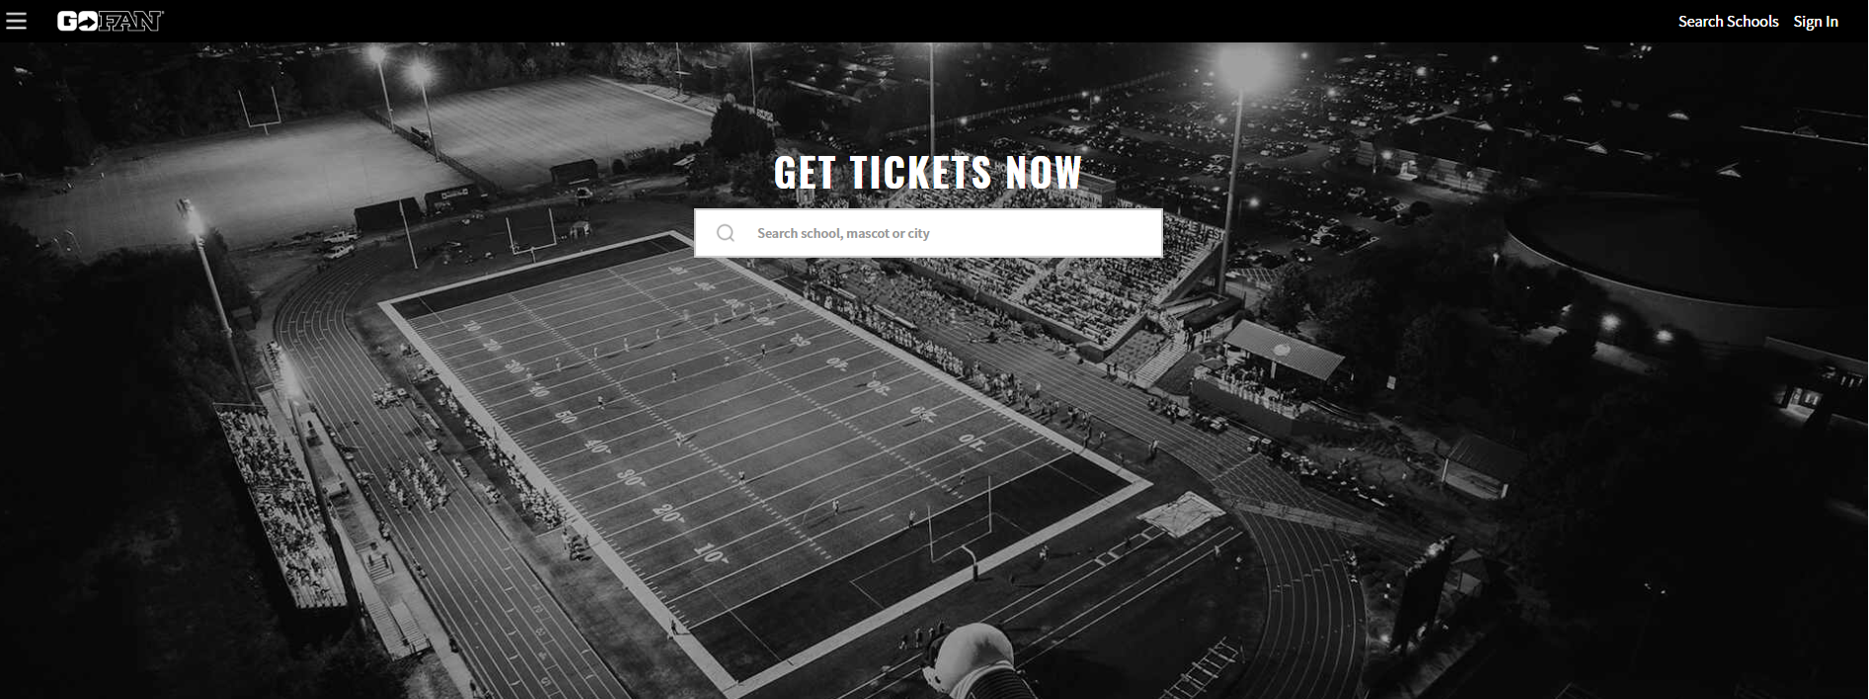
Ticketing through GoFan ~ https://gofan.co/search

Slide 25
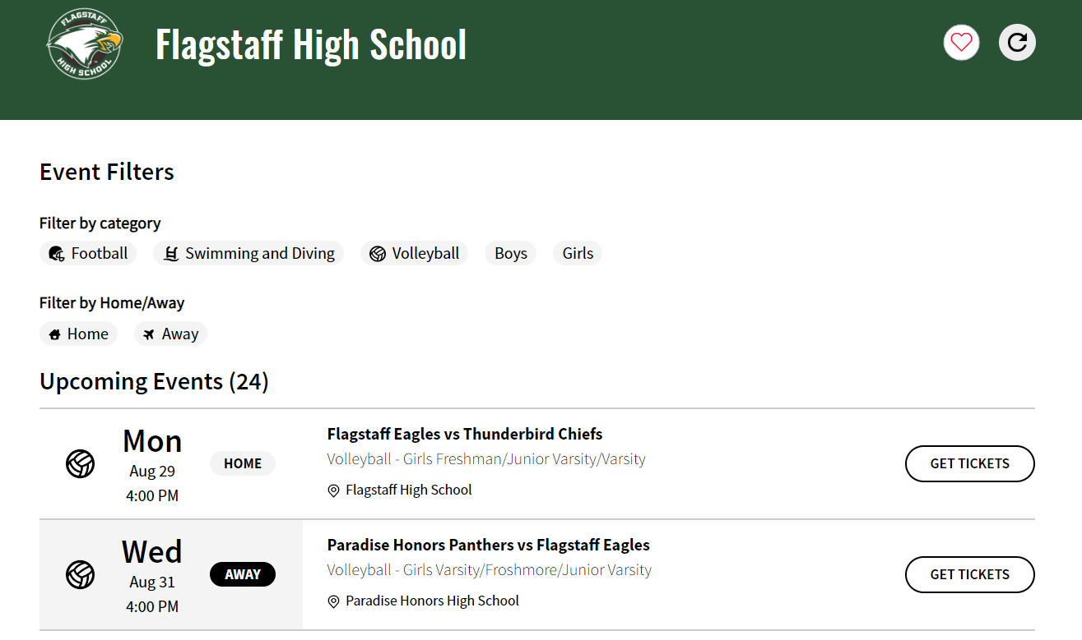
GoFan

Slide 26
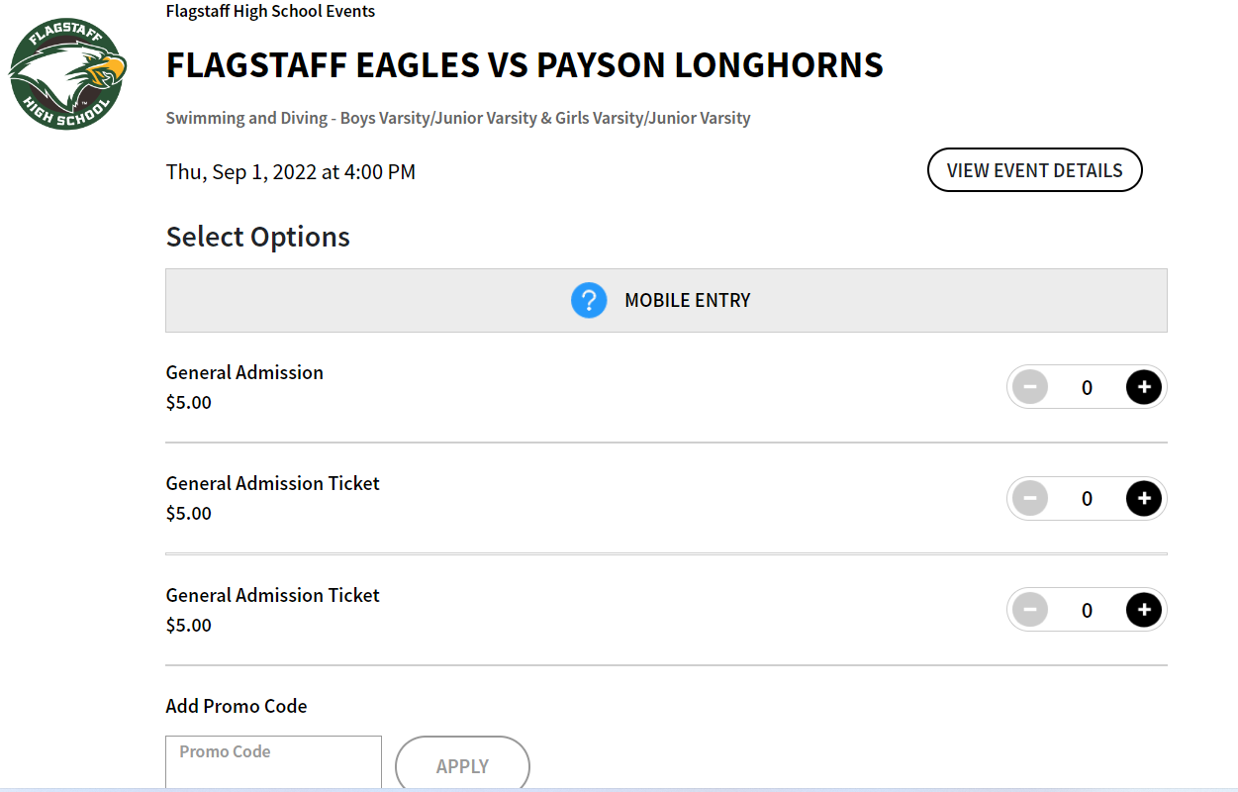
GoFan

Slide 27
ATHLETIC PASSES
We will be selling Athletic Passes this year. These passes will get you into all home contests with the following exceptions:
Games at the NAU Skydome
Tournaments
Pepsi Tournament
State Games
$50 for Adults and $25 for Students K-12

Slide 28
EXPECTATIONS
STUDENT-Athlete
Keep up with Class Work
Grades Checked Every 3 Weeks (Schedule posted on our website)
Passing All Classes
1st F can remediate, subsequent F’s miss 3 weeks
School Philosophy
Attendance
Sportsmanship
Respect
Parking
Locker Rooms

Slide 29
LOCKER ROOM
Lockers and Locks will be assigned after tryouts
USE THEM
Locker room is not secure and students need to be diligent
Monitor from 2:30pm to 3:00pm
After 3:00pm doors will be locked and locker room inaccessible
Take everything with you
Don’t prop doors
No horseplay
Change and get out
Not a hang out

Slide 30
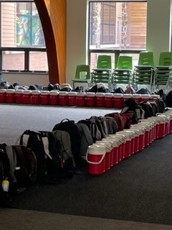
Be focused, be prepared

Slide 31
PARKING
Park only in legal spaces
Athletes should not drive to the field or the gym
Short walk from Kendrick to the field traveling between the building and the field
A new asphalt path is being installed
Limited parking at field for coaches and mobility impaired
DO NOT PARK IN THE FIRE LANE this is for the safety of your athlete
Gates will be locked

Slide 32
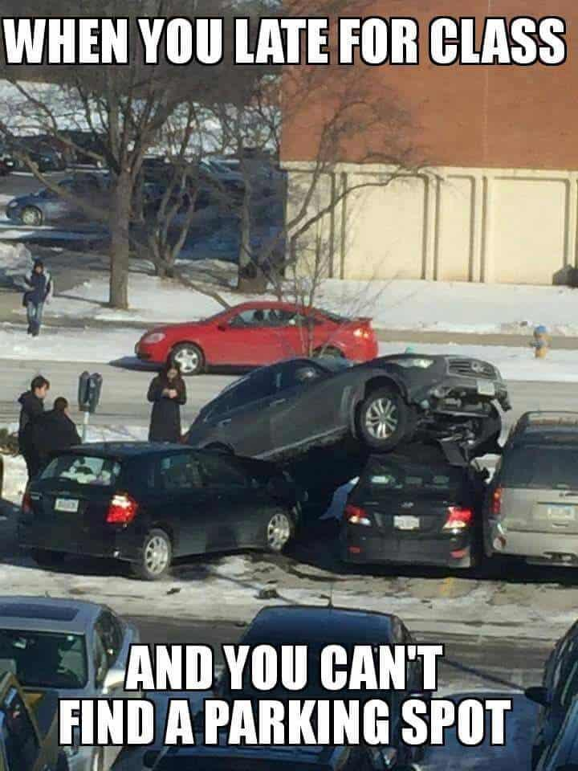
Parking is a challenge, so please don’t park on your neighbor ☺
Parking for games is on Kendrick
On street
In lots

Slide 33
EXPECTATIONS
Athletic Handbook
Available ~
FHS Website
FinalForms Website
Please review and understand the expectations to be a student-athlete at Flagstaff High School

Slide 34
COMMUNICATION
We are here to help, please contact us if you need assistance. However please remember that when contacting coaches it is important that you do it away from competition, right before and right after a competition are difficult times to give you the attention you deserve, so please allow some time to pass before approaching a coach with a frustration or concern.

Slide 35
Welcome and Have Fun
“Always remember – Breathe and Adjust”
Stay Safe and most importantly --
ONCE AN EAGLE, ALWAYS AN EAGLE

